Slide 1
Plotting Data
WK DSS 220 Module 2 Lesson 3
Notes:
The whole reason we do data science is to find simple, relevant, and easy to understand stories of mountains of data. So you can see why data visualization is so important.

Slide 2
Phases
Exploratory Data Analysis
Presenting Results
Notes:
You’ll usually work with data visualizations during two phases
During exploratory data analysis, you’ll do a lot of plotting that doesn’t need to be polished.
You’re doing work to figure out what the data is telling you, to find that story, to see trends and relationships
You only need to focus on your own viewpoint and that of your peers when deciding on format
At the end of your project, you need to tell the story that you learned from the data.
You need to think about who your audience is
You should present your data visualizations that are clear, and easy to understand.
You audience should be able to get the main point of your visualization within 5 seconds of seeing it, without you narrating

Slide 3
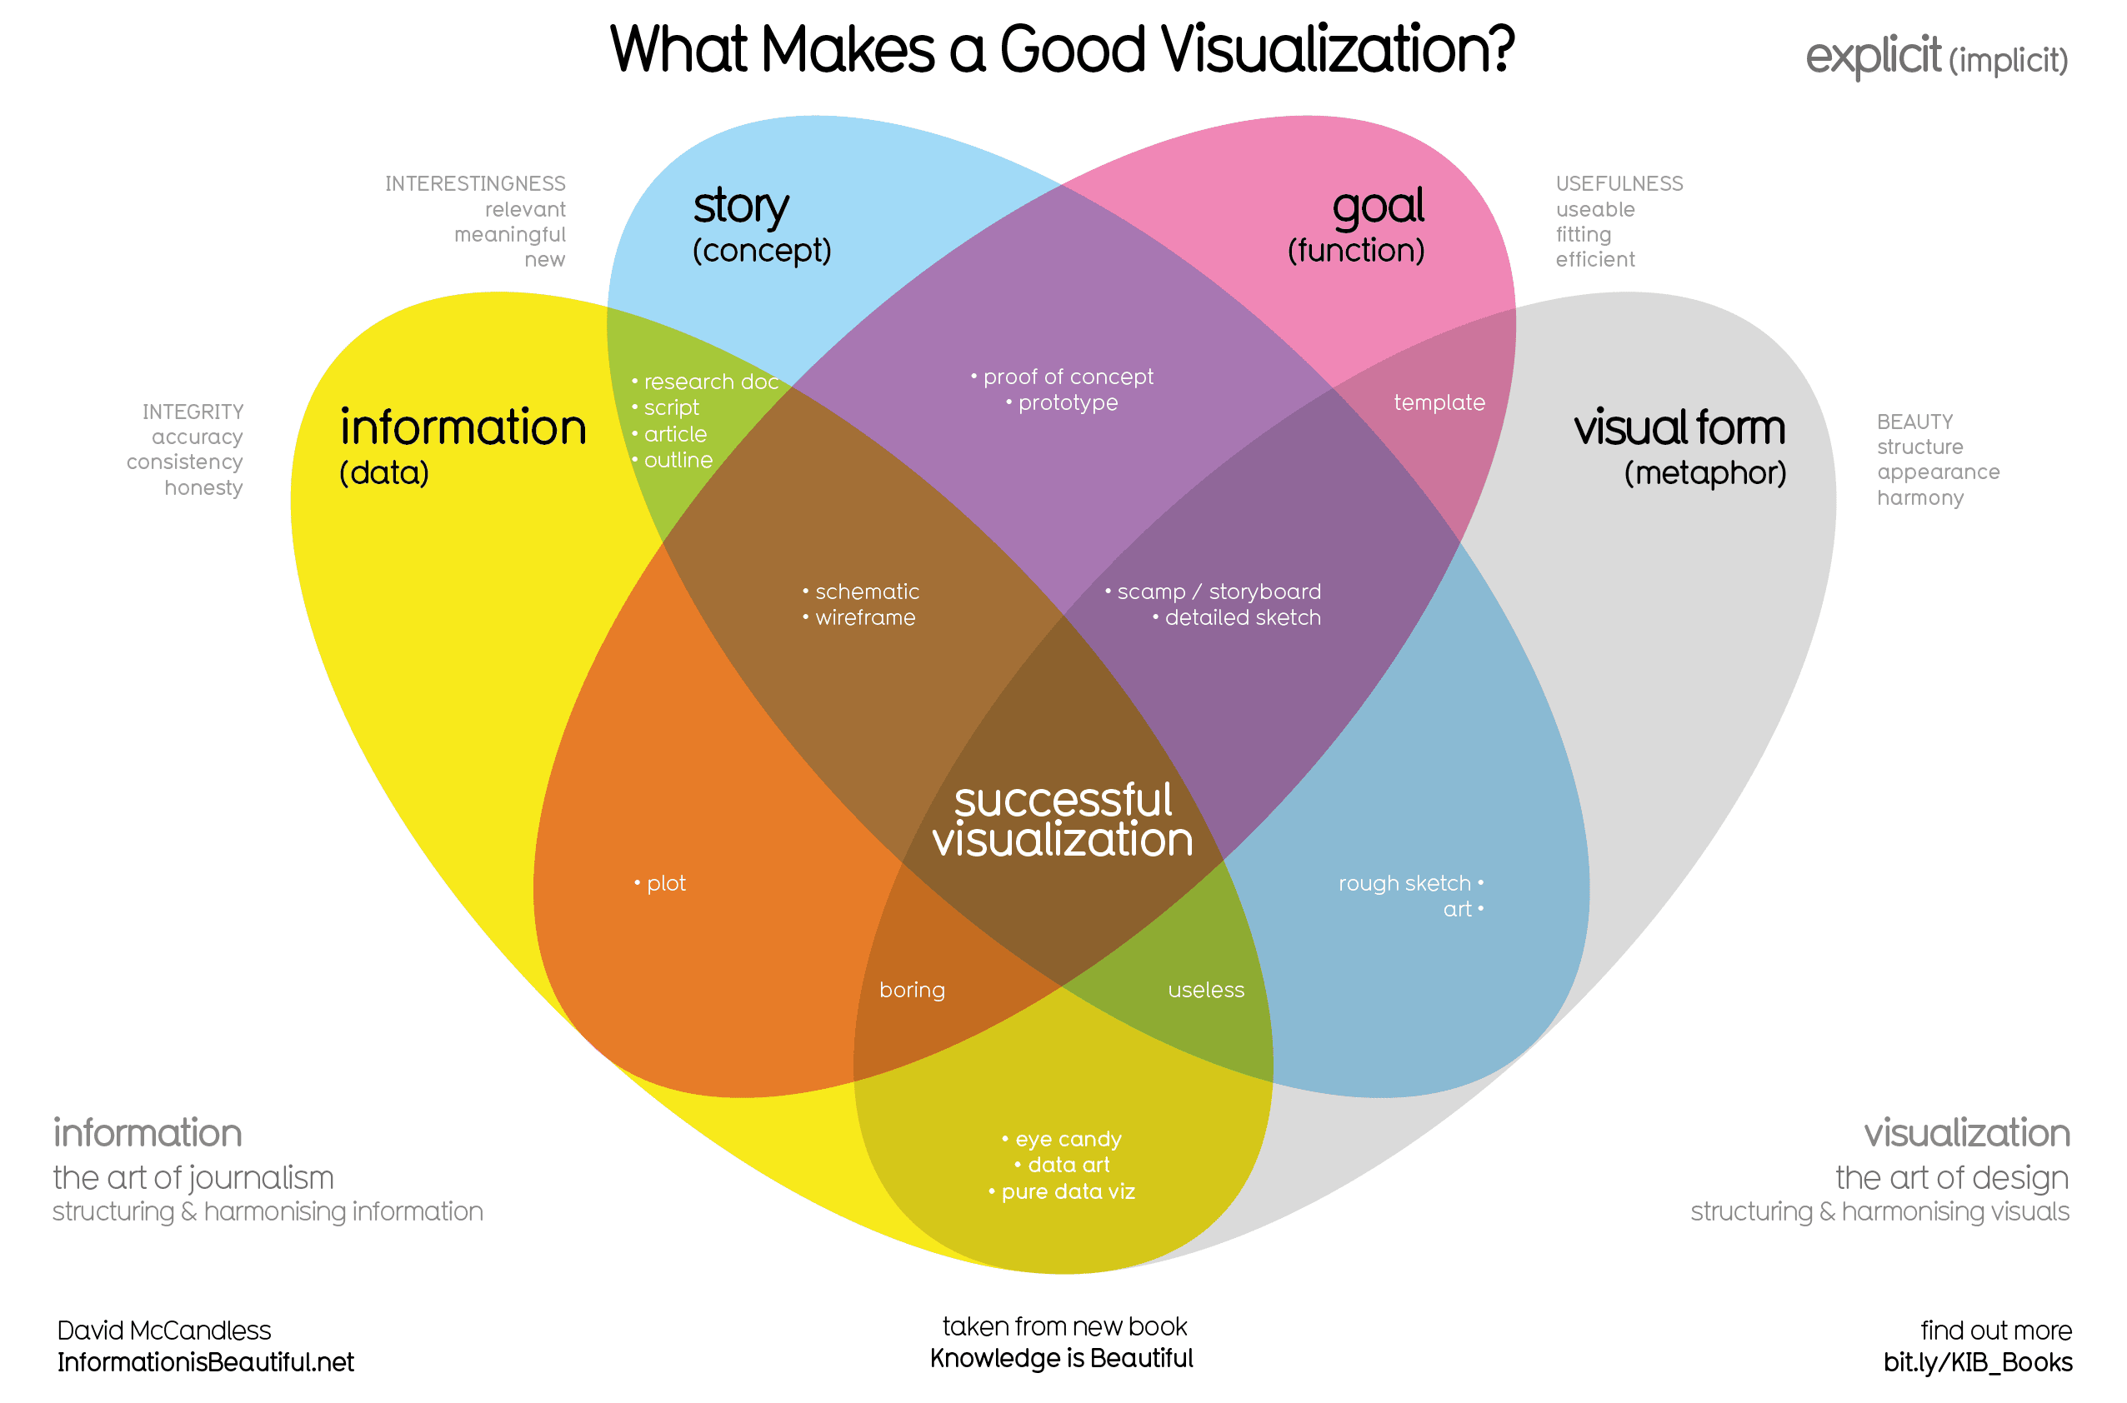
Notes:
There are lots of different schools of thought on what goes into making a good data visualization.
This visualization comes from David McCandless (https://www.informationisbeautiful.net/visualizations/what-makes-a-good-data-visualization/)
He explains that successful visualization is an intersection of a Story, Goal, Visual Form, and Information.
Story: a clear and compelling narrative or concept
Information: the data you are working with
Goal: a specific objective or function for the visual
Visual form: the beauty, appearance (an effective use of metaphor or visual expression)
Later on, we’ll go over some ideas on how to present well.

Slide 4
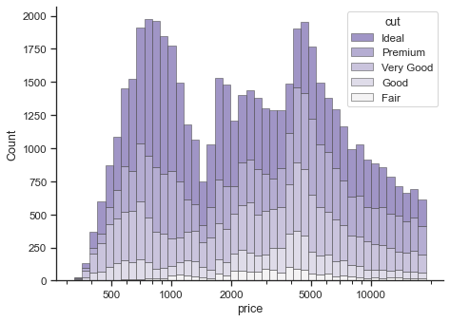
Plotting Fundamentals
Single Variable
Histogram, Density Plot
Notes:
The type of chart you use will depend on what data you have.

Slide 5
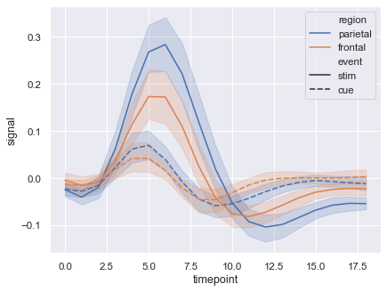
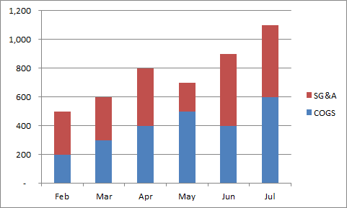
Plotting Fundamentals
Measurement Change Over Time
Bar Chart, Line Chart
Notes:
The type of chart you use will depend on what data you have.

Slide 6
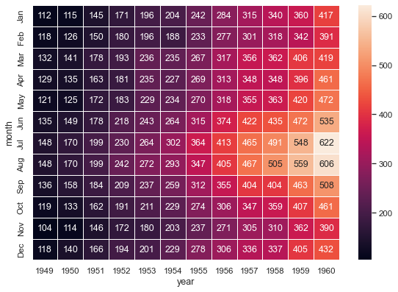
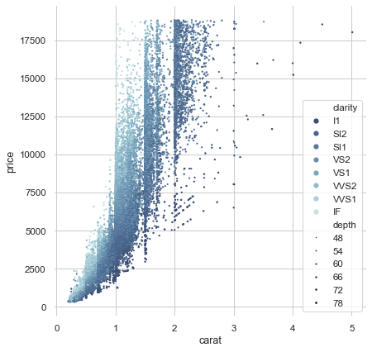
Plotting Fundamentals
Relationship Between Variables
Scatter Plot, Heat Map
Notes:
The type of chart you use will depend on what data you have.

Slide 7
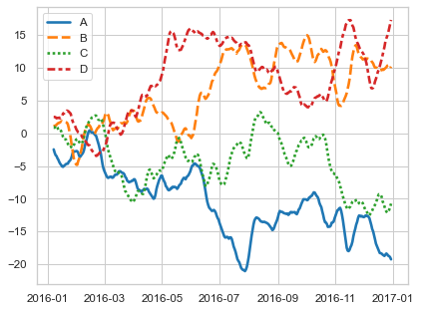
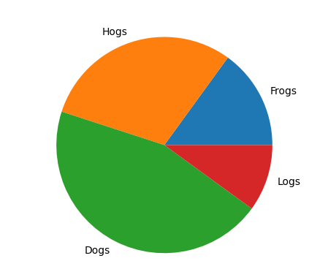
Plotting Fundamentals
Multiple Datasets
Line Chart, Pie Chart
Notes:
The type of chart you use will depend on what data you have.

Slide 8
Plotting Libraries
Fundamental
Matplotlib, Seaborn
Advanced
Tableau, Plotly
Notes:
Matplotlib: https://matplotlib.org/
- https://matplotlib.org/stable/tutorials/introductory/quick_start.html
Seaborn: https://seaborn.pydata.org/tutorial/function_overview.html
Tableau Public: https://public.tableau.com/en-us/s/
- Example GIF: https://www.tableau.com/products/desktop

